Slide 1
.NET Introduction

Slide 2
Application Types (cons without .NET):
Desktop Applications (c, c++, vb, power builder)
Web Applications (php, jsp, asp, java script)
Mobile Applications
Cons:
we can not use same language for different applications

Slide 3
.NET Advantages
OOP
Great caching system
Cross platform development
Easy to deploy and maintain
It supports N number languages

Slide 4
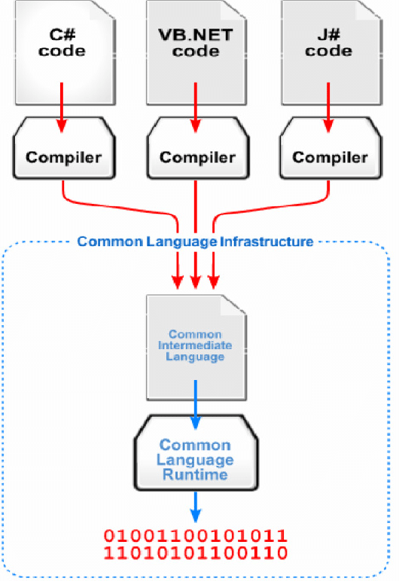
.NET Framework Architecture

Slide 5
Components of .NET Framework
CLR (Common language runtime)
BCL/FCL (Base class library/Framework class library)
CLR (Common language runtime):
Runtime execution engine of the .NET application and act as a interface between OS and .NET application

Slide 6
Features of CLR
Garbage collector
Exception handling
Thread management
Convert to native language

Slide 7
Components in CLR
Common Language Specification (CLS)
Common Type System (CTS)
Just In – Time Compiler (JIT)

Slide 8
CLS(Common language specification)
It is responsible for converting the different .NET programming language syntactical rules and regulations into CLR understandable format
ex : C# | VB
; for statement termination ; is not used

Slide 9
CTS(Common type system)
Every programming language has its own data type system, so CTS is responsible for understanding all the data type systems of .NET programming languages and converting them into CLR understandable format which will be a common format.
C# | VB | CLR
int integer int32

Slide 10
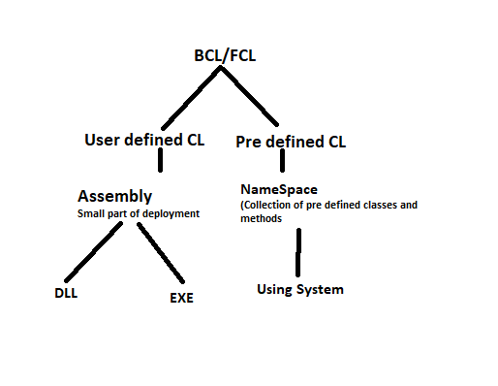
BCL/FCL

Slide 11
DLL vs EXE
DLL | EXE
Dyanamic Link Library | Executable file
Reusability | Output Application
It will not contain main method | It contains main method

Slide 12
Memory management in .NET

Slide 13
Heap that can be divided into two parts
Small Object Heap
Large Object Heap
Stack
.NET also uses stack to keep track of everything.
Obj o = new Obj(); Heap
stack
O
--------
Methods
variables
o | ref
10001054

Slide 14
SOH(Small object Heap)
All objects that are smaller than 85KB are allocated to a small object heap.
SOH is particularly on hit here as most of the objects are smaller than 85KB and those objects are also usually short-lived, which means that they are very frequently created and then destroyed.

Slide 15
Heap
Obj o1 = new Obj();
o1
After some memory allocation and deallocation the heap look like this
o1 |  |  | o4 | o5
objects on SOH are allocated consecutively, one on top of the other, instead of looking for free space between used memory blocks, even if there is free space available.

Slide 16
.NET does not leave this as is and resolves this issue on memory deallocation. When some object is destroyed and deallocation occurs, .NET will perform memory compaction. This means that it will shift all objects in the heap by copying them in order to fill those free gaps with existing objects and leave free space at the top of the heap. Copying objects around is a performance-expensive operation but with that, .NET is able to achieve a balance between performance and efficiency.
O1 | O4 | O5

Slide 17
LOH(Large object heap)
Those objects that are larger than 85KB go to a large object heap, but why we use LOH instead of SOH
Now that we saw how SOH maintains objects, it is clear that performance impact with memory compaction increases with size of objects. In order to mitigate this impact, .NET uses LOH that has quite a different mechanism for memory management.
The key difference between the SOH and LOH is LOH does not perform memory compaction operation instead of it maintains a free space table. When some objects are destroyed or deallocated, it will just write in that table the start and end addresses of destroyed objects.

Slide 18
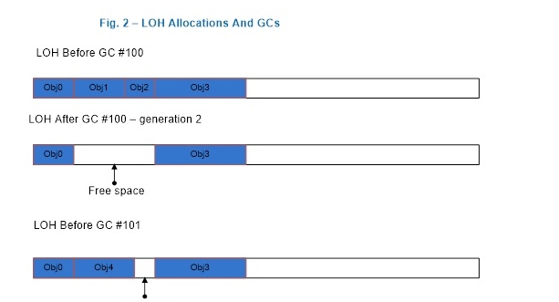
Free space table
From | To
1500 | 1600
0 | 800

Slide 19
Garbage Collection
The garbage collector (GC) manages the allocation and release of memory. The garbage collector serves as an automatic memory manager.
To clear the memory we have two ways
Manual(It leads to errors)
Automatic

Slide 20
Generations of Heap Memory
Heap Memory can be divided into three generations
Generation 0
is the youngest generation all the newly created are assigned to this generation
Generation 1
It will contain Long live objects
Generation 2
it will contains Longest live objects

Slide 21
Working of GC
Obj1
Obj2
Obj3
Obj4
Obj5
Obj6
Gen 0
Objects that survive a generation 0 garbage collection are promoted to generation 1.
Objects that survive a generation 1 garbage collection are promoted to generation 2.
Objects that survive a generation 2 garbage collection remain in generation 2.
Gen 1
Gen 2

Slide 22
Phases of GC
Marking Phase:
A marking phase that finds and creates a list of all live objects.
Relocating Phase:
A relocating phase that updates the references to the objects that will be compacted.
Compacting Phase:
It clears the un used objects in the heap

Slide 23
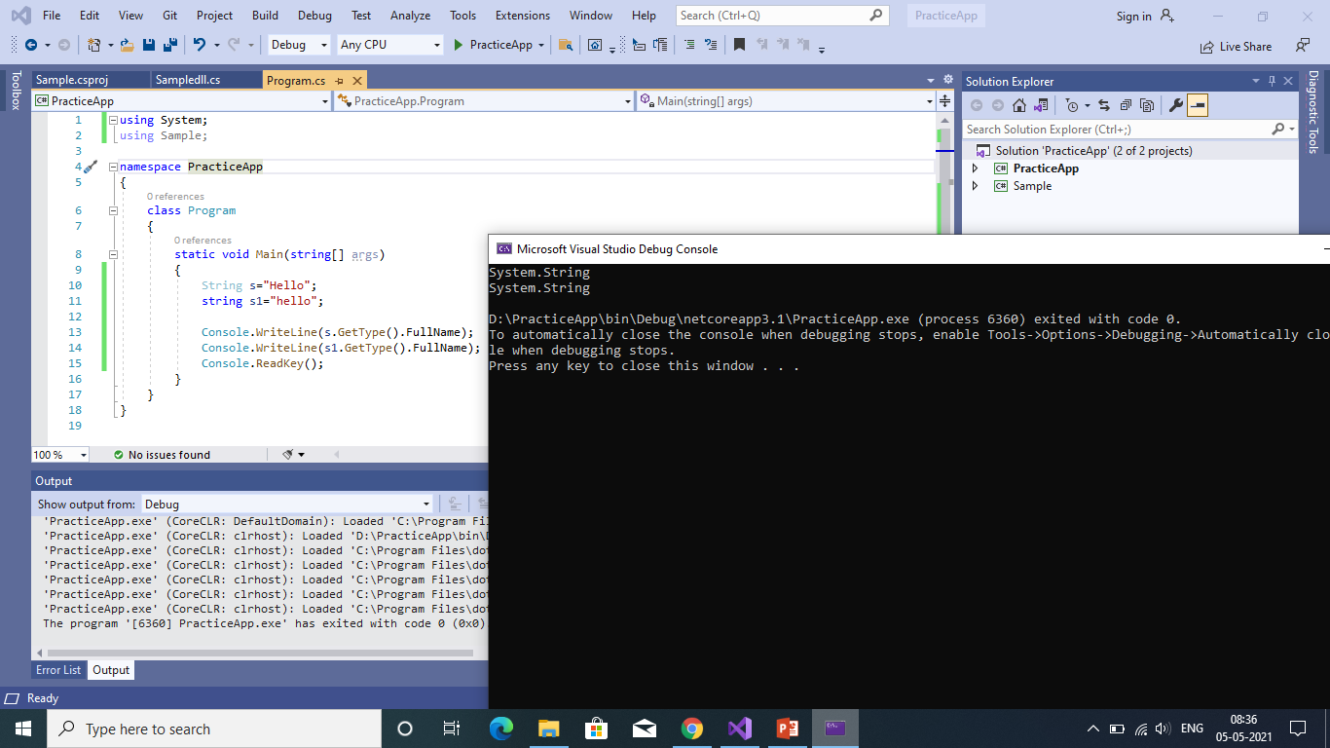
String (capital S) is a class in the .NET framework in the System namespace. The fully qualified name is System.String. Whereas, the lower case string is an alias of System.String.

Slide 24
String pooling
The string intern pool is a table that contains a single reference to each unique literal string declared or created programmatically in your application. The Common Language Runtime (CLR) uses the intern pool to minimize string storage requirements. As a result, an instance of a literal string with a particular value only exists once in the system.

Slide 25
String s = “hello”
String s1=“hello”
S1=“Hello”
s
hello
Hello
s1
s1

Slide 26
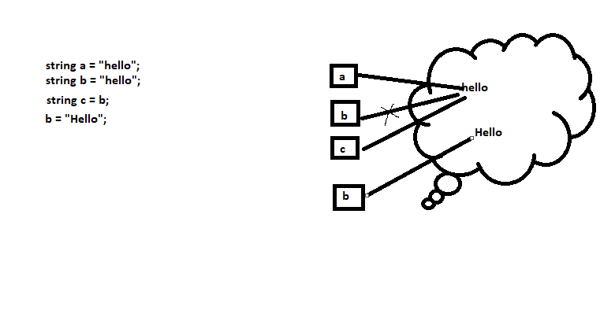
String memory allocation

Slide 27
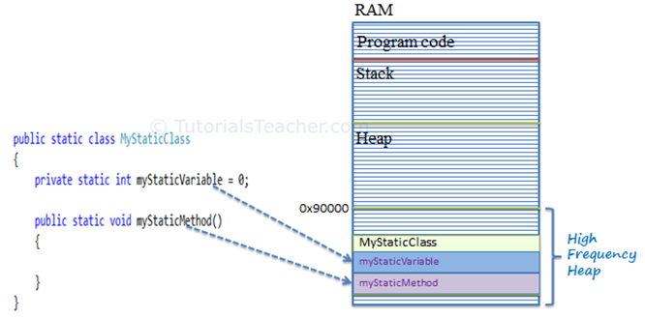
Static class Memory allocation

Slide 28
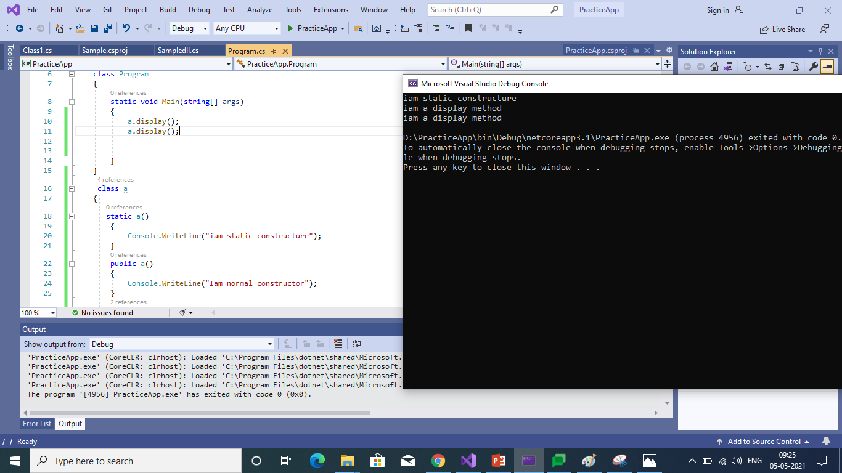
Static block

Slide 29
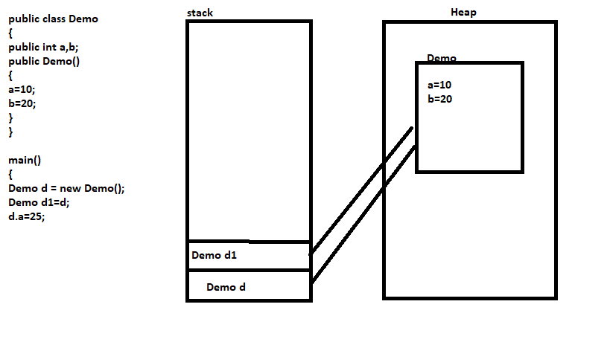
Memory allocation of Classes

Slide 30
GAC (Global Assembly cache)
GAC contains strong named assemblies. Assemblies in the GAC can be shared by all applications running on that machine, without having to copy the assembly locally.
It is recommended to install an assembly into GAC, only when required and shared by applications, otherwise they should be kept private.
You shouldn’t add an assembly into the GAC, if you wish to deploy your application to another machine using XCopy deployment. This is because in XCopy deployment, we only copy the application files to the target machine and not the GAC contents.
Note : XCopy deployment is simply copying files from one location to another.

Slide 31
Types of Assemblies
There are two types of assemblies
Private assembly
Public assembly

Slide 32
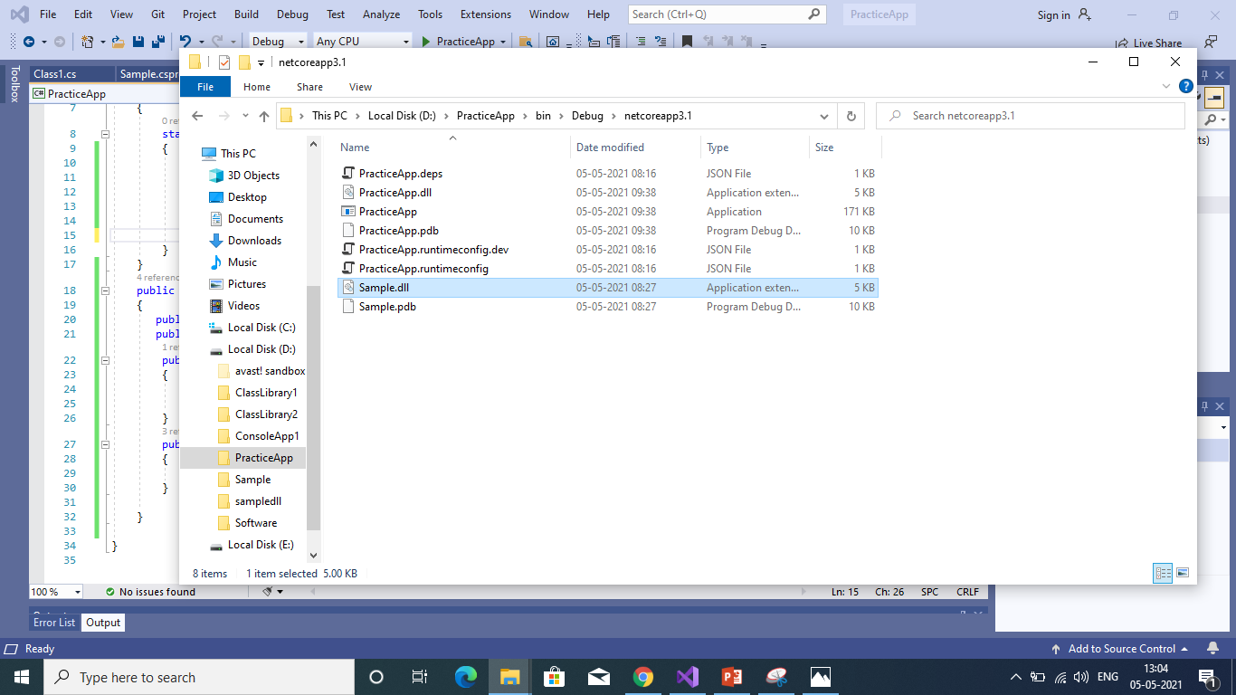
Private Assembly
In private assembly we need dll file all the used application
For example add.dll is file we need to access this on myApp then we need to add the dll into this myApp

Slide 33
Public Assembly
we need strong naming an assembly
Assembly name will consists of four parts
Simple Textual name
Version number
Cultural information
Public key token
In order to create public assembly we need public key to generate public key we run the command on visual studio command prompt
Sn.exe –k D:\keyname.snk
Add the assemply key file into AssemblyInfo.cs file
[assembly:AssemblyKeyFile(“D:\keyname.snk”)]

Slide 34
Install Assembly in GAC
To install Assembly we need to run the following command
gacutil.exe -I sample.dll
Now our dll will be successfully installed on gac.

Slide 35
History of .NET
1950 – 1960
cobal -> Mathemetical applications
pascal -> Bussiness applications
fortron -> Scientific applications
1970 – 1972
c language
1980’s
c++ introduced with oops concept
1990’s
Internet was introduced
1995
java

Slide 36
1999
com(component object model) by Microsoft
pros:
drag and drop feature
cons:
incomplete oops
platform dependent(runs in only windows)
2002
.NET was introduced
it supports multiple languages
it supports 60+ languages
out of 60, 9 were developed by Microsoft
language interoperability

Slide 37
Versions
1.0 -> 2002 (not supports web applications)
1.1 -> 2003 (inbuilt web application development feature)
2.0 -> 2005 (Generics, partial classes included)
3.0 -> 2006 (WPF, WCF, WF)
3.5 -> 2008 (linq)
4.0 -> 2010 (Integrated Silverlight application)
4.5 -> 2012 (Metro apps using windows 8)
4.6 -> 2015 (changes in base class library
Resizing in windows form controls
support for code page encoding)
4.7 -> 2017 (High DPI support for windows forms
touch support for WPF
Enhanced cryptography support
performance and reliable)
4.8 -> 2019 (JIT Improvements
NGEN improvements
anti malware scanning for all assemblies(dll, exe)
Reducing FIPS impact on cryptography)

Slide 38
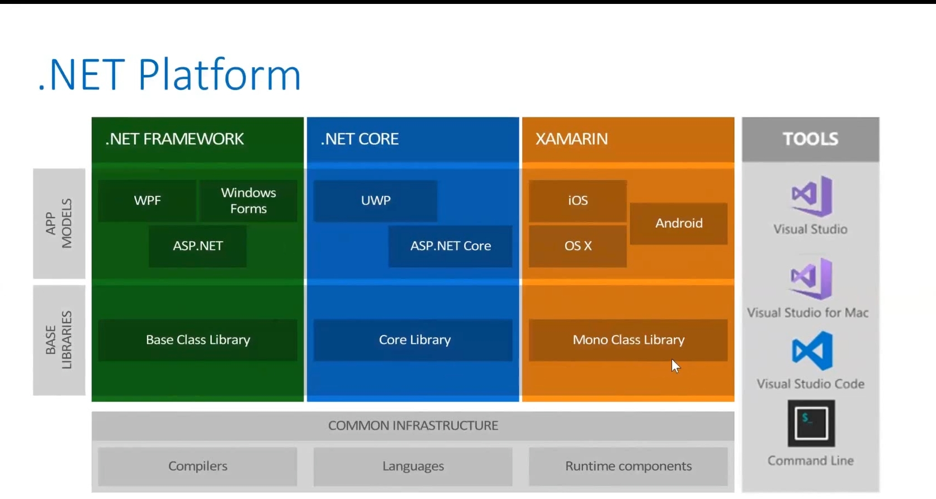

Slide 39
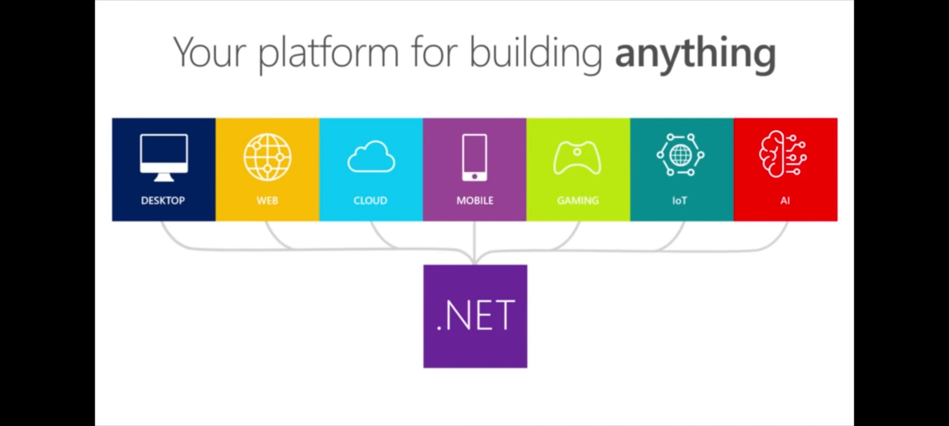

Slide 40
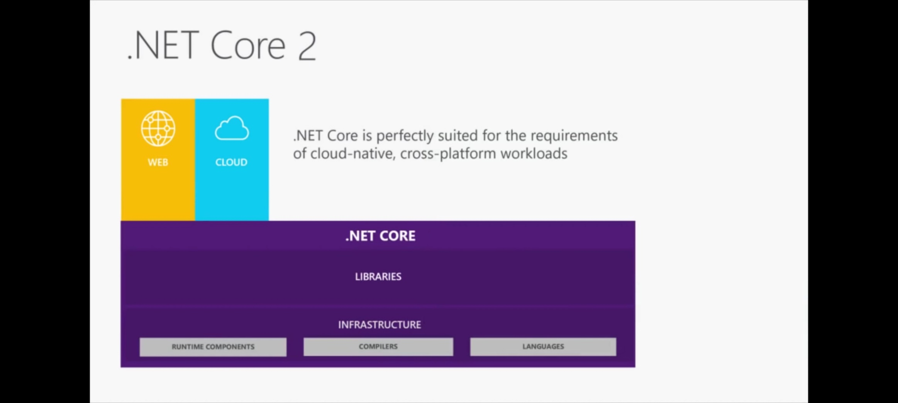

Slide 41
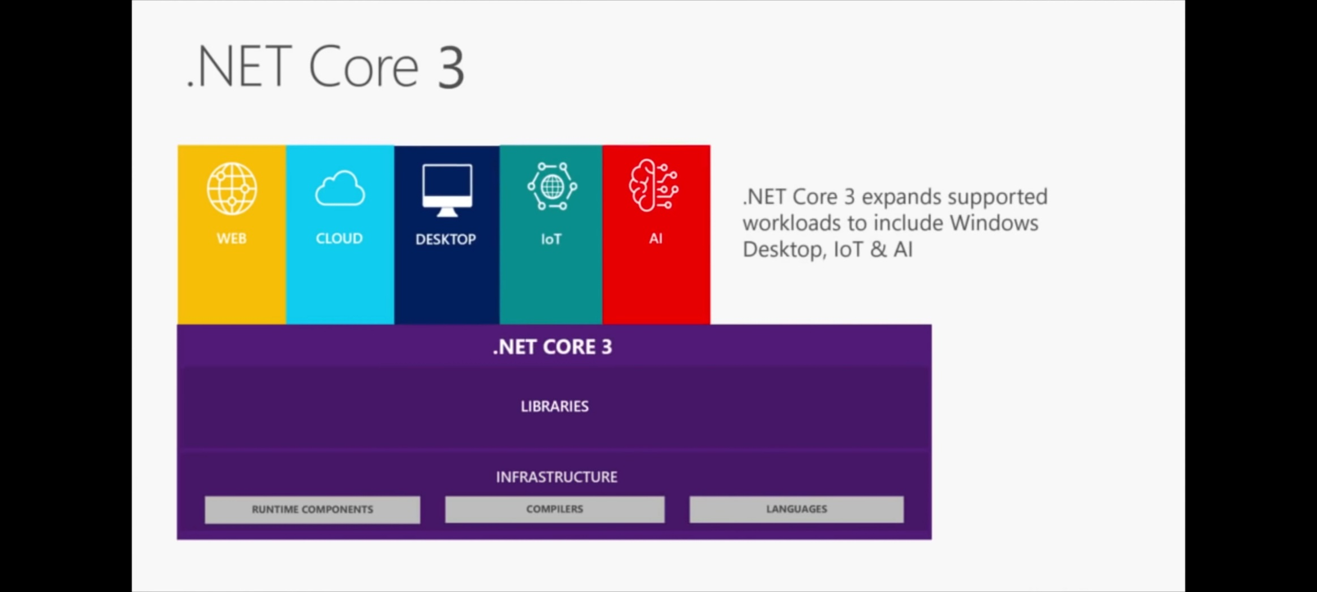

Slide 42
BASED ON | .NET Core | .NET Framework
Open Source | .NET Core is an open source. | Certain components of the .NET Framework are open source.
Cross-Platform | Works on the principle of “build once, run anywhere”. It is compatible with various operating systems — Windows, Linux, and Mac OS as it is cross-platform. | .NET Framework is compatible with the windows operating system.
Application Models | .NET Core does not support desktop application development and it rather focuses on the web, windows mobile, and windows store. | .NET Framework is used for the development of both desktop and web applications as well as it supports windows forms and WPF applications.
Installation | .NET Core is packaged and installed independently of the underlying operating system as it is cross-platform. | .NET Framework is installed as a single package for Windows operating system.
Support for Micro-Services and REST Services | .NET Core supports the development and implementation of micro-services and the user has to create a REST API for its implementation. | .NET Framework does not support the development and implementation of microservices but it supports the REST API services.
Performance and Scalability | .NET Core offers high performance and scalability. | .NET Framework is less effective in comparison to .NET Core in terms of performance and scalability of applications.

Slide 43
BASED ON | .NET Core | .NET Framework
Compatibility | .NET Core is compatible with various operating systems — Windows, Linux, and Mac OS. | .NET Framework is compatible only with the Windows operating system.
Android Development | .NET Core is compatible with open-source mobile application platforms, i.e. Xamarin, through the .NET Standard Library. Developers use Xamarin’s tools to configure the mobile app for specific mobile devices such as iOS, Android, and Windows phones. | .NET Framework does not support any framework for mobile application development.
Packaging and Shipping | .NET Core is shipped as a collection of Nugget packages. | All the libraries of .NET Framework are packaged and shipped together.

Slide 44
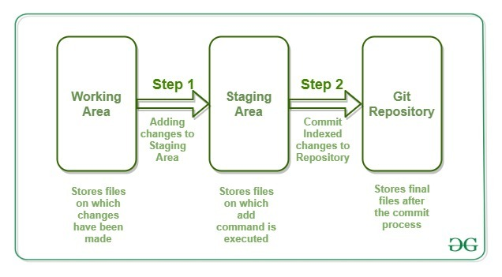
Git Repository

Slide 45
Git init command
The git init command creates a new Git repository
Executing git init creates a .git subdirectory in the current working directory, which contains all of the necessary Git metadata for the new repository. This metadata includes subdirectories for objects, refs, and template files. A HEAD file is also created which points to the currently checked out commit.

Slide 46
Git add command
Adding changes to the Index
This process is done by the use of git add command. When the changes have been made in the Working Tree/Area. These changes need to be added to the Staging Area for further modification of the file. git add command adds the file in the local repository. This stages them for the commit process.

Slide 47
Different ways to use add command:
$ git add <fileName>
To add a specific list of files to staging area.
$ git add --all
To add all files of current directory to staging area.
$ git add *.txt
To add all text files of the current directory to staging area.
$ git add docs/*.txt
To add all text files of a particular directory(docs) to staging area.
$ git add docs/
To add all files in a particular directory(docs) to staging area.

Slide 48
Git Remote command
git remote add <name> <url>
Create a new connection to a remote repository. After adding a remote, you’ll be able to use as a convenient shortcut for in other Git commands.
git remote
List the remote connections you have to other repositories.
git remote –v
Same as the above command, but include the URL of each connection.
git remote rm <name>
Remove the connection to the remote repository called
git remote rename <old-name> <new-name>
Rename a remote connection from to .

Slide 49
Git status Command
git status
List which files are staged, unstaged, and untracked.
git log
Display the entire commit history using the default formatting. If the output takes up more than one screen, you can use Space to scroll and q to exit.
git log -n <limit>
Limit the number of commits by . For example, git log -n 3 will display only 3 commits.

Slide 50
git commit command
The git commit command captures a snapshot of the project's currently staged changes
git commit -m "commit message“
A shortcut command that immediately creates a commit with a passed commit message.
git commit -am "commit message“
A power user shortcut command that combines the -a and -m options.

Slide 51
git push command
The git push command is used to upload local repository content to a remote repository.
git push <remote> <branch>
Push the specified branch to , along with all of the necessary commits and internal objects.
git push -f <remote> <branch>
Same as the above command, but force the push even if it results in a non-fast-forward merge.
git push <remote> --all
Push all of your local branches to the specified remote.

Slide 52
git pull command
he git pull command is used to fetch and download content from a remote repository and immediately update the local repository to match that content.
git pull <remote> <branch>
Fetch the specified remote’s copy of the current branch and immediately merge it into the local copy

Slide 53
git clone command
which is used to target an existing repository and create a clone, or copy of the target repository
git clone <remote>
This will give you the remote project into our system
git clone <remote> <directory>
Clone the repository located at ＜repo＞ into the folder called
＜directory＞ on the local machine.

Slide 54
git branch command
A branch in Git is simply a lightweight movable pointer to one of these commits. The default branch name in Git is master
git branch
List all of the branches in your repository. This is synonymous with git branch --list.
git branch <branch>
Create a new branch called <branch> This does not check out the new branch.
git branch -d <branch>
Delete the specified branch. This is a “safe” operation in that Git prevents you from deleting the branch if it has unmerged changes.
git branch -D <branch>
Force delete the specified branch, even if it has unmerged changes.
git branch -m <branch>
Rename the current branch to <branch>
git branch -a
List all remote branches.

Slide 55
git checkout command
The git checkout command is used to switch between branches in a repository.
git checkout <branchname>
this command is used to switch to the branches
git checkout -b <branchname>
The git checkout commands let you create and switch to a new branch.

Slide 56
NuGet packages
An essential tool for any modern development platform is a mechanism through which developers can create, share, and consume useful code. Often such code is bundled into "packages" that contain compiled code (as DLLs) along with other content needed in the projects that consume these packages.

Slide 57
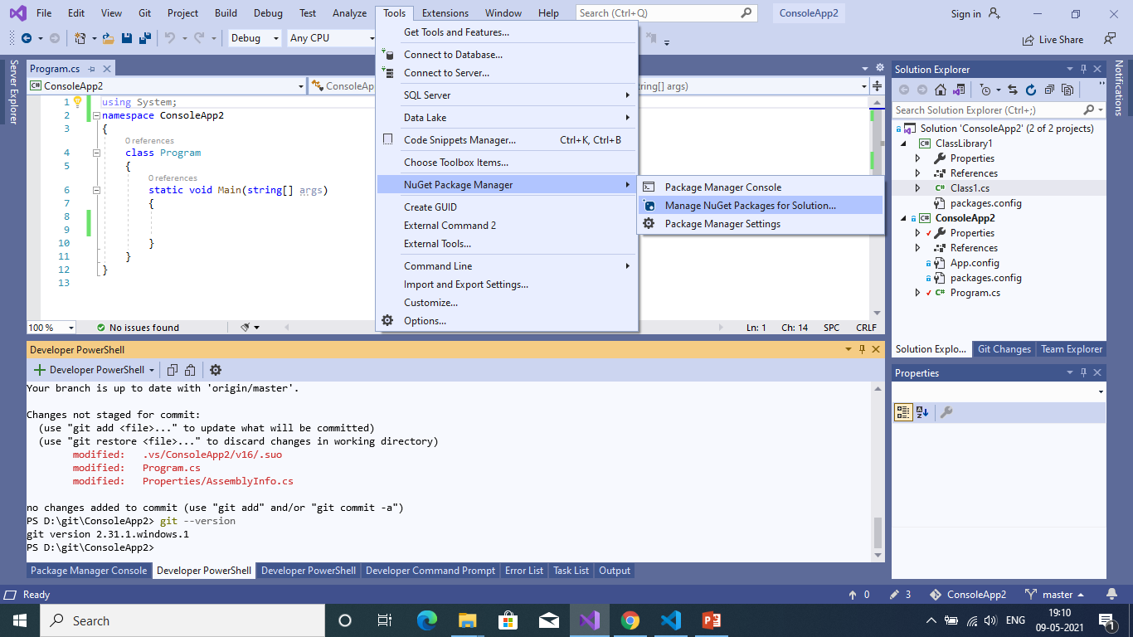
How to install NuGet package in VS 2019

Slide 58
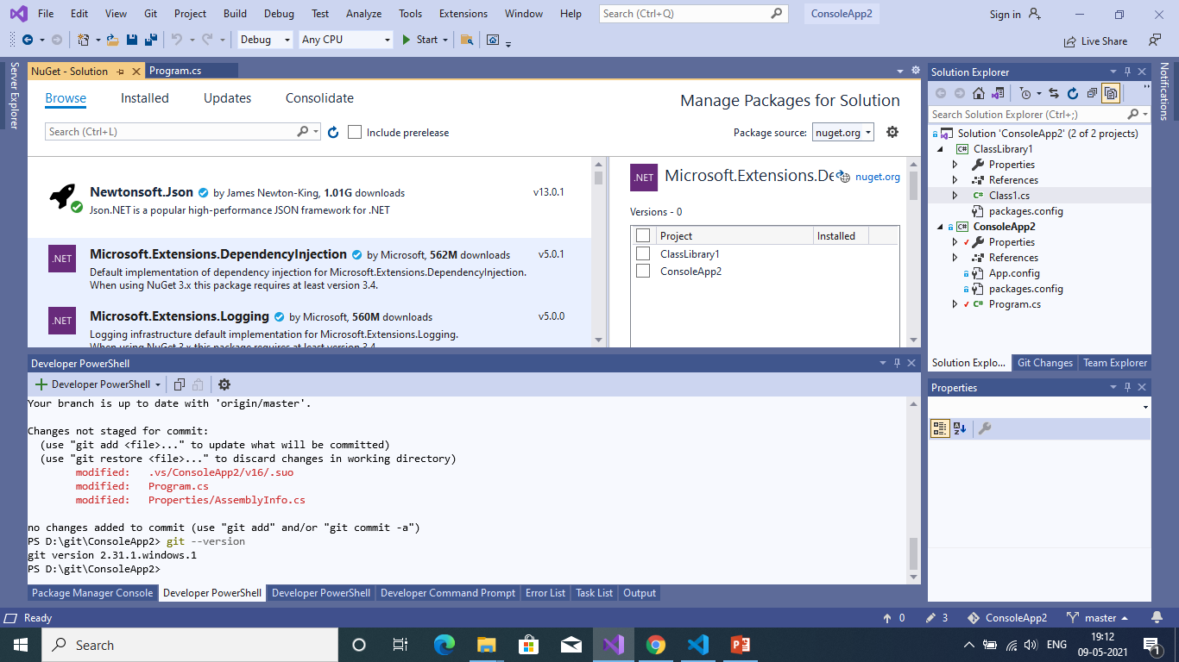

Slide 59
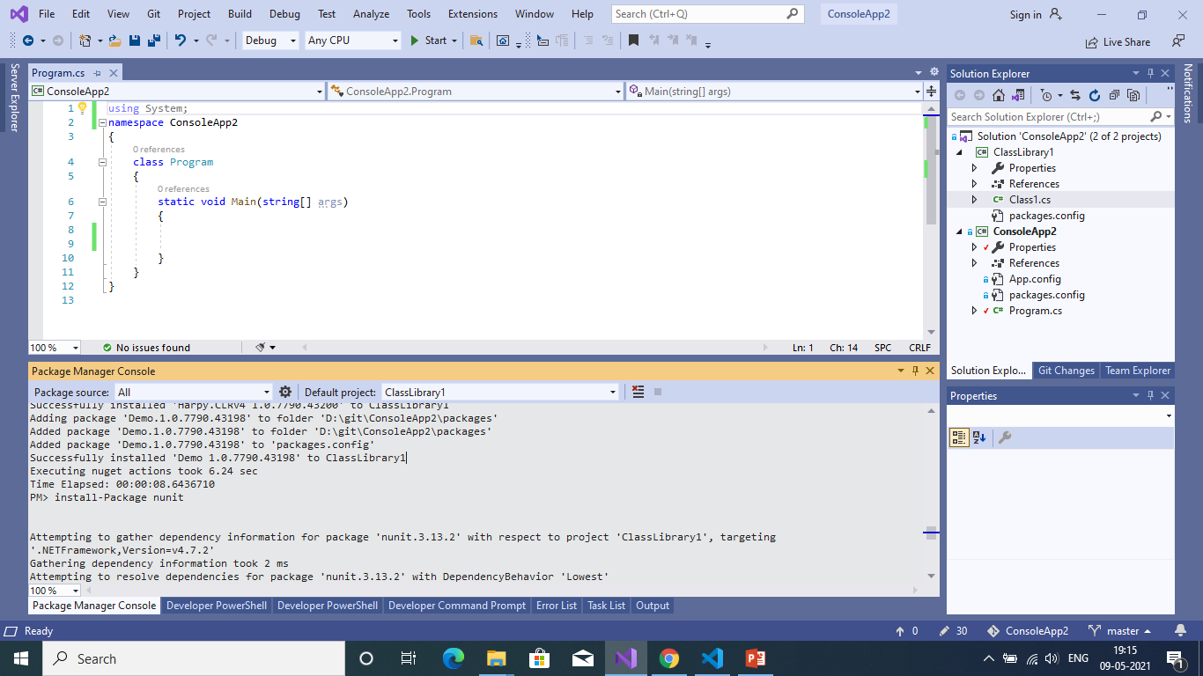
Install package using PMC

Slide 60

Install package with specific version in PMC

Slide 61
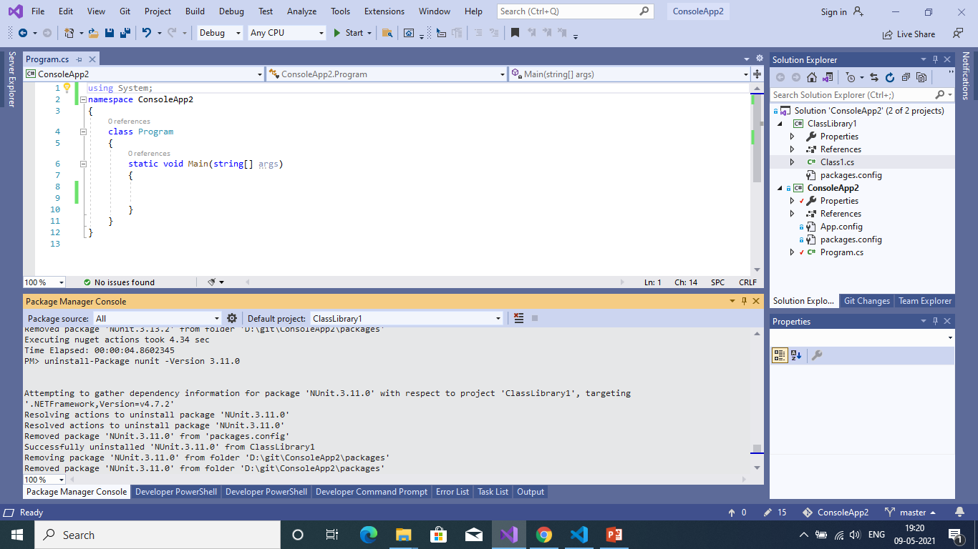
Deleting NuGet Package using PMC

Slide 62
GUID
GUID is a unique identifier, you can use this for identifying the particular component.
GUIDs are usually stored as 128-bit values, and are commonly displayed as 32 hexadecimal digits with groups separated by hyphens, such as {DA1FFC57-62EE-4019-9BAE-D5670339CD1C}.

Slide 63
GUID usage
Imagine that you have a point-of-sale application that is available in both online and offline modes on your mobile application. Assume that your application provides ID numbers that are automatically generated starting from 1. How can you merge the offline data when the connectivity is restored? What if your ID numbers have been generated in both modes? There can be collisions, right? How would you handle duplicate ID numbers? You could definitely handle this but you would have to write a lot of code — which is not what you want to do.

Slide 64
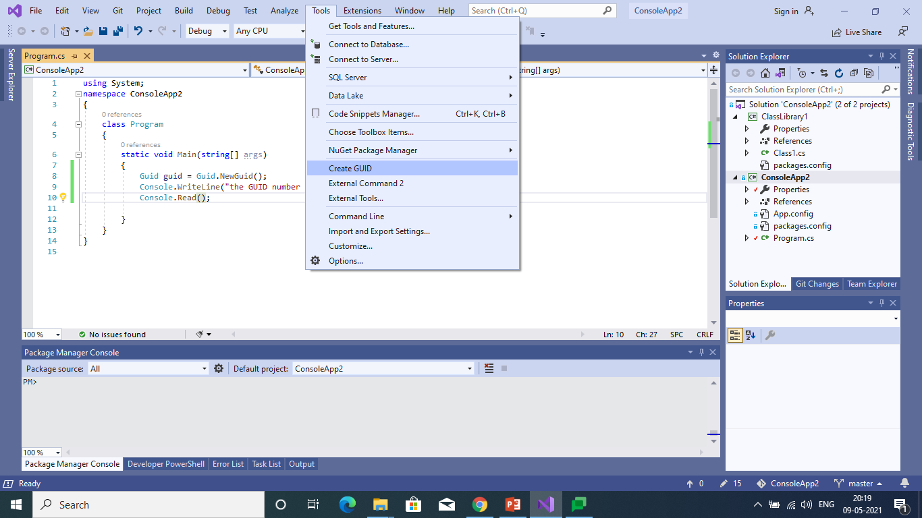
Generating GUID in VS2019

Slide 65
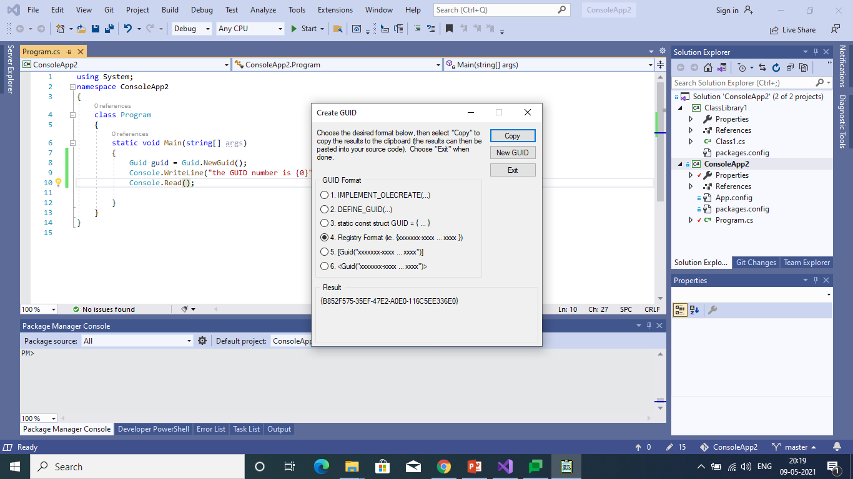

Slide 66


Slide 67
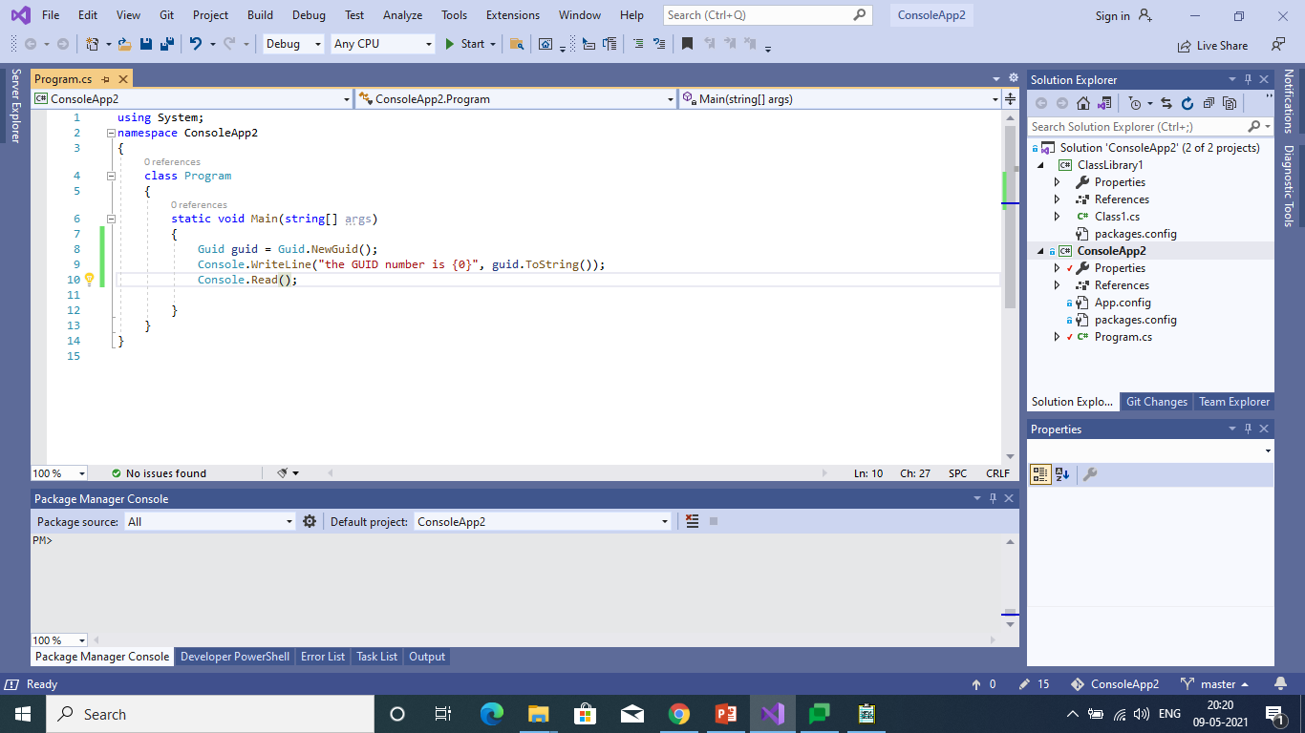
Creating GUID with C#

Slide 68
Data lake
A Data Lake is a storage repository that can store a large amount of structured, semi-structured, and unstructured data. It is a place to store every type of data in its native format with no fixed limits on account size or file. It offers a large amount of data quantity for increased analytical performance and native integration.

Slide 69
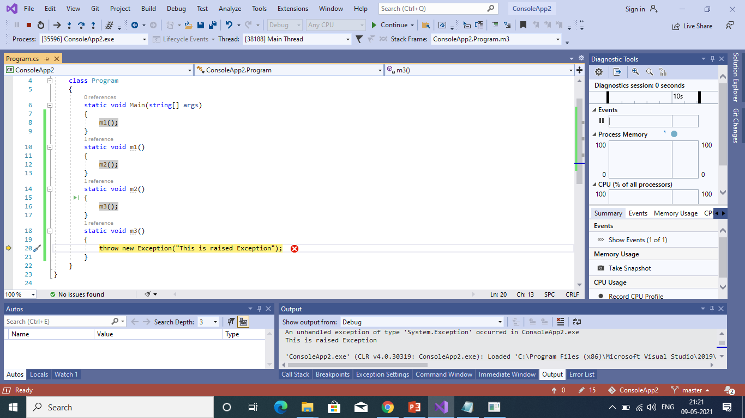
Debug vs Relese
In Debug mode it clearly shows the stack information of the error

Slide 70
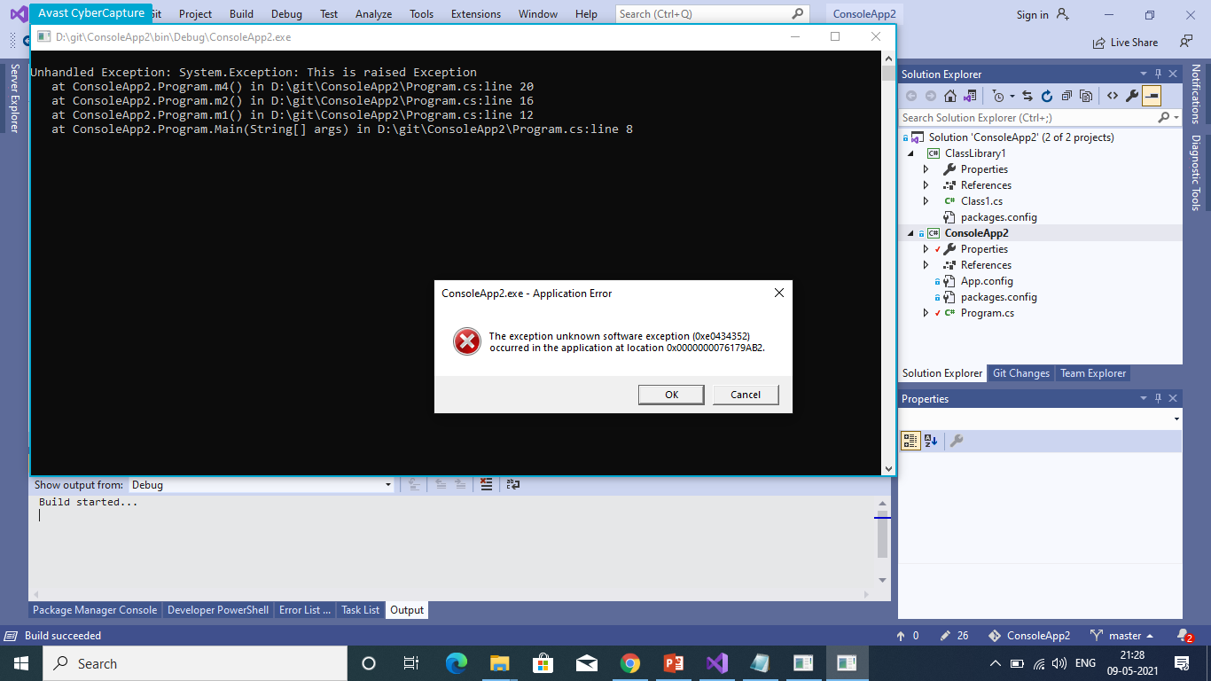

Slide 71
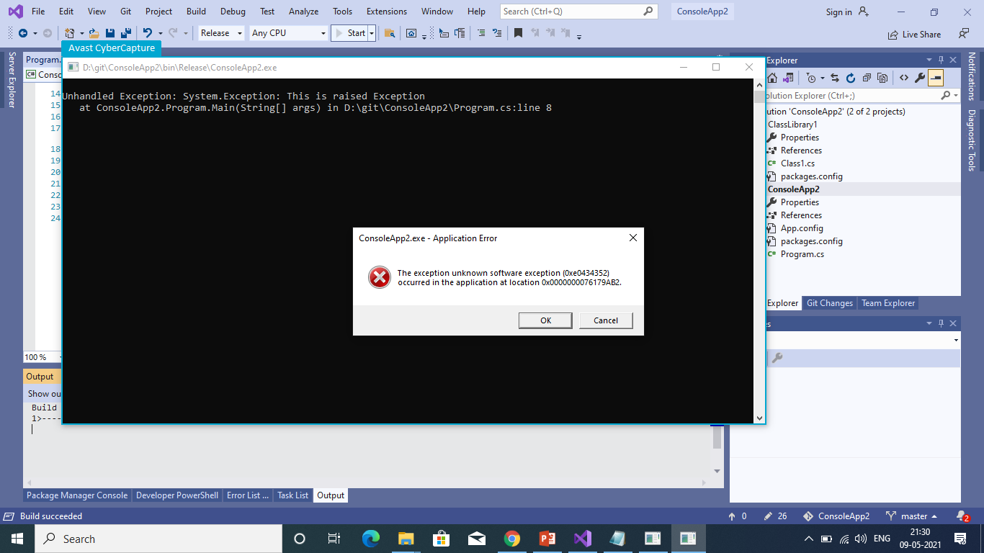
In ReleseMode

Slide 72
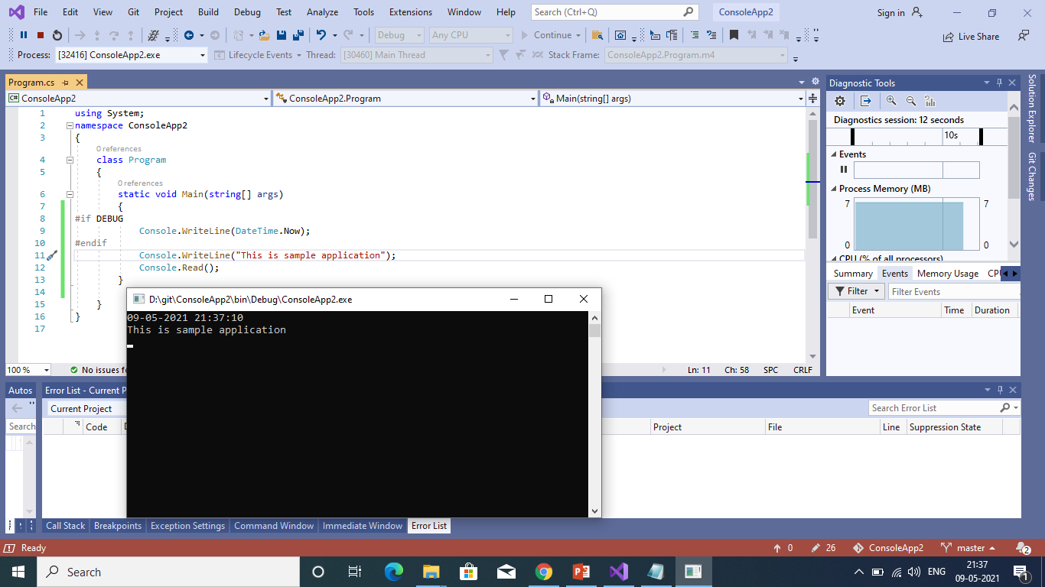
Debug symbols are not shipped to production

Slide 73
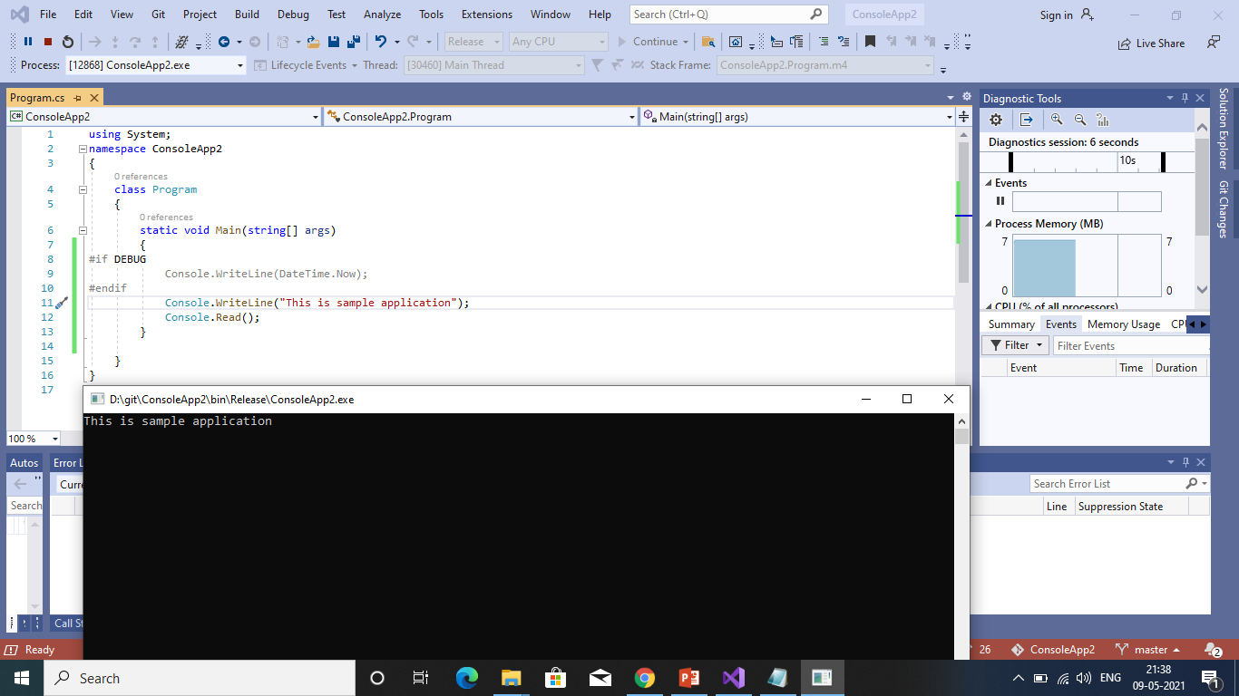

Slide 74
C# introduction

Slide 75
C# is pronounced as "C-Sharp". It is an object-oriented programming language provided by Microsoft that runs on .Net Framework.
By the help of C# programming language, we can develop different types of secured and robust applications:
Window applications
Web applications
Distributed applications
Web service applications
Database applications etc.
C# programming language is influenced by C++, Java, Eiffel, Modula-3, Pascal etc. languages.

Slide 76
Difference between java and c#
Java | C#
Java programming language is designed to be run on a Java platform, by the help of Java Runtime Environment (JRE). | C# programming language is designed to be run on the Common Language Runtime (CLR).
In java, built-in data types that are passed by value are called primitive types. | In C#, built-in data types that are passed by value are called simple types.
Arrays in Java are direct specialization of Object. | Arrays in C# are specialization of System.
Java doesn't support goto statement. | C# supports goto statement.
Java doesn't support structures and unions. | C# supports structures and unions.

Slide 77
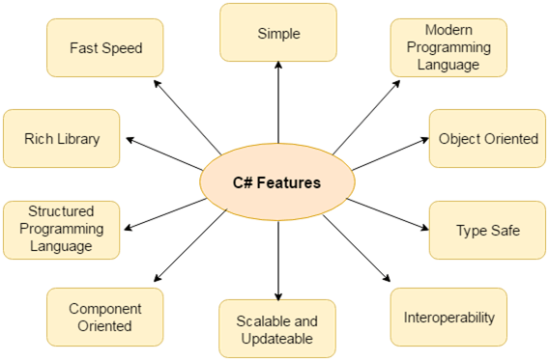
Features of C#

Slide 78
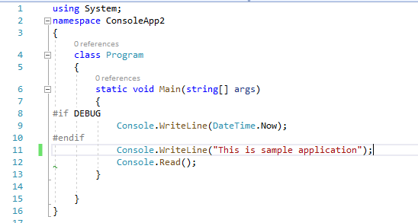
C# Example: Using namespace

Slide 79
Program: is the class name. A class is a blueprint or template from which objects are created. It can have data members and methods. Here, it has only Main method.
static: is a keyword which means object is not required to access static members. So it saves memory.
void: is the return type of the method. It does't return any value. In such case, return statement is not required.
Main: is the method name. It is the entry point for any C# program. Whenever we run the C# program, Main() method is invoked first before any other method. It represents start up of the program.
string[] args: is used for command line arguments in C#. While running the C# program, we can pass values. These values are known as arguments which we can use in the program.
System.Console.WriteLine("Hello World!"): Here, System is the namespace. Console is the class defined in System namespace. The WriteLine() is the static method of Console class which is used to write the text on the console.

Slide 80
C# Variable
A variable is a name of memory location. It is used to store data. Its value can be changed and it can be reused many times.
It is a way to represent memory location through symbol so that it can be easily identified.
Rules for defining variables
A variable can have alphabets, digits and underscore.
A variable name can start with alphabet and underscore only. It can't start with digit.
No white space is allowed within variable name.
A variable name must not be any reserved word or keyword e.g. char, float etc.

Slide 81
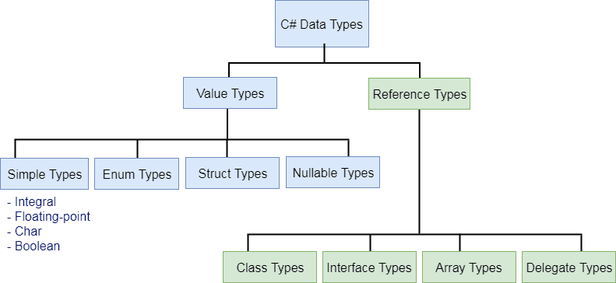
C# - Data Types

Slide 82
Type | Description | Range | Suffix
byte | 8-bit unsigned integer | 0 to 255
sbyte | 8-bit signed integer | -128 to 127
short | 16-bit signed integer | -32,768 to 32,767
ushort | 16-bit unsigned integer | 0 to 65,535
int | 32-bit signed integer | -2,147,483,648 to 2,147,483,647
uint | 32-bit unsigned integer | 0 to 4,294,967,295 | u
long | 64-bit signed integer | -9,223,372,036,854,775,808 to 9,223,372,036,854,775,807 | l
ulong | 64-bit unsigned integer | 0 to 18,446,744,073,709,551,615 | ul
float | 32-bit Single-precision floating point type | -3.402823e38 to 3.402823e38 | f
double | 64-bit double-precision floating point type | -1.79769313486232e308 to 1.79769313486232e308 | d
decimal | 128-bit decimal type for financial and monetary calculations | (+ or -)1.0 x 10e-28 to 7.9 x 10e28 | m
char | 16-bit single Unicode character | Any valid character, e.g. a,*, \x0058 (hex), or\u0058 (Unicode)
bool | 8-bit logical true/false value | True or False
object | Base type of all other types.
string | A sequence of Unicode characters
DateTime | Represents date and time | 0:00:00am 1/1/01 to 11:59:59pm 12/31/9999

Slide 83
Alias vs .NET Type
The predefined data types are alias to their .NET type (CLR class) name. The following table lists alias for predefined data types and related .NET class name.
Alias | .NET Type | Type
byte | System.Byte | struct
sbyte | System.SByte | struct
int | System.Int32 | struct
uint | System.UInt32 | struct
short | System.Int16 | struct
ushort | System.UInt16 | struct
long | System.Int64 | struct
ulong | System.UInt64 | struct
float | System.Single | struct
double | System.Double | struct
char | System.Char | struct
bool | System.Boolean | struct
object | System.Object | Class
string | System.String | Class
decimal | System.Decimal | struct
DateTime | System.DateTime | struct

Slide 84
String Formatters

Slide 85
Data and Time
CHARACTER | DESCRIPTION | USAGE | EXAMPLE
d | Short Date | {0:d} | 19-03-2021
D | Long Date | {0:D} | 19 March 2021
t | Short Time | {0:t} | 06:49:20
T | Long Time | {0:T} | 06:49:20
f or F | Long Date Time | {0:f} | 19 March 2021 06:49:00
g or G | Short Date Time | {0:g} | 19-03-2021 06:49:44
M | Short Date | {0:M} | March 19
r | RFC1123 Date Time String | {0:r} | Thu, 19 March 2021 06:49:22 GMT
s | Sortable Date/Time | {0:s} | 2021-03-19T06:49:11
u | Universal Sortable Date | {0:u} | 2021-03-19 06:49:49Z
U | Universal full date | {0:U} | 19 March 2021 00:18:55
Y | Year month pattern | {0:Y} | March, 2021

Slide 86
Short date:
C.W("{0:d}",datetime); //output : 5/12/2021
Long date:
C.W("{0:D}",datetime); //output : Wednesday, May 12, 2021
Short Time:
C.W("{0:t}",datetime); //output : 6:15 AM
Long time:
C.W(“{0:T}”,datetime); //output : 6:15:24 AM
Long Date Time:
C.W(“{0:f (or) F}”,datetime); //output :Wednesday, May 12, 2021 6:20 AM
Short Date Time:
C.W(“{0:g (or) G}”,datetime); //output : 5/12/2021 6:22 AM
Universal Date and Time:
C.W(“{0:U}”,datetime); //output :Wednesday, May 12, 2021 6:20 AM
Year Month pattern:
C.W(“{0:Y}”,datetime); //output : May 2021

Slide 87
Character | Description | Usage | Example
c | Currency | {0:c} | $ 75,674.74
e | Scientific | {0:e} | 7.567474e+004
f | Fixed Point | {0:f} | 75674.74
g | General | {0:g} | 75674.73789621
n | Thousand Separator | {0:n} | 75,674.74

